Slide 1



ZENLISH – HỌC TOEIC 1 LẦN LÀ ĐẠT
BEGINNER’S TOEIC
LESSON 9

Slide 2



ZENLISH – HỌC TOEIC 1 LẦN LÀ ĐẠT
BEGINNER’S TOEIC
LESSON 9
THỰC HÀNH PART 3 (2)

Slide 3


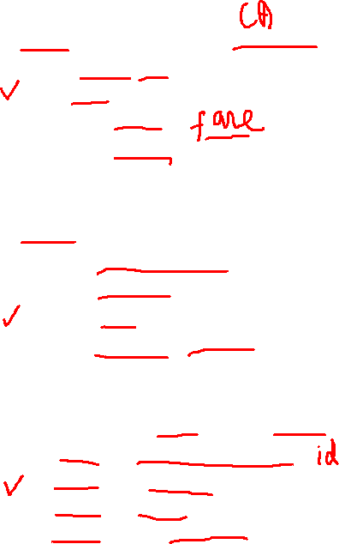
1
1
What are the speakers discussing?
A. An arrival time
B. A seat assignment
C. A ticket price
D. A Travel policy
in my seat
W-Am: Excuse me, sir, but I think you're (1) ............ ..........., 14-A?
M-Au: Let me take a look at my ticket... hmm, no, it seems I'm in the (2) ............... ............... My ticket says 14- A as well.
W-Am: Well... this is (3) ............. .............. ............. Are you sure you're in the right car?
M-Au: Oh, pardon me! I'm 14-A in car six. I've (4)
............ ............. .............on the (5) ......................... rack, so just give me a moment to get my things together.
2
Where is the conversation taking place?
right place
A. In a parking garage
B. At a car rental agency
C. On a train
D. In a baggage claim area
train car five
3
What does the man say he will do?
A. Show his identification card
B. Gather his luggage
C. Ask for a refund
D. Speak with a supervisor
put my bags
overhead

Slide 4
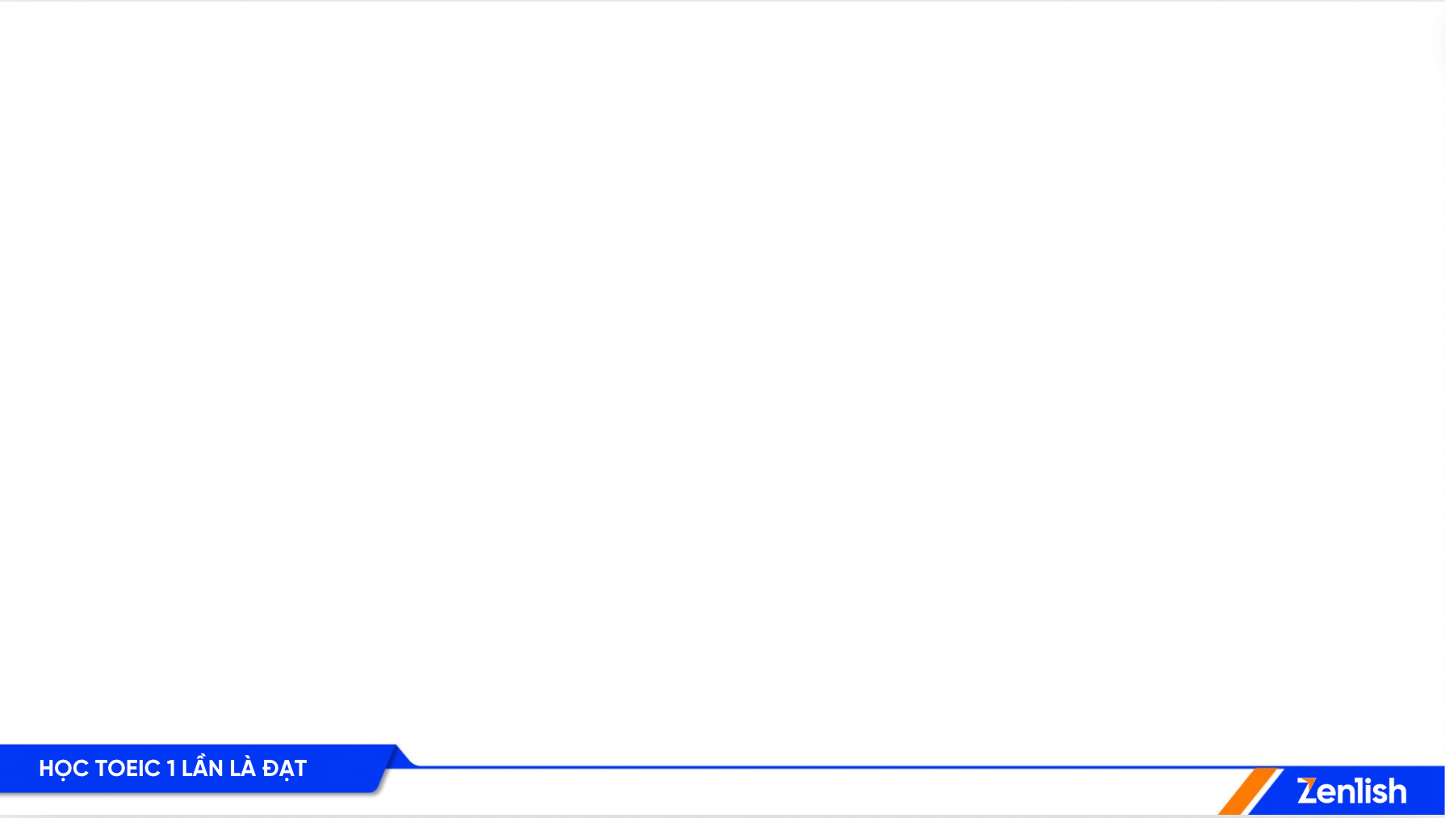
VOCABULARY
Assignment /əˈsaɪn.mənt/ (n): nhiệm vụ, sự phân công
Parking garage /ˈpɑːkɪŋ ɡəˈrɑːʒ/: ga-ra đỗ xe
Car rental agency /kɑːr ˈrɛntəl ˈeɪdʒənsi/: công ty cho thuê xe
Baggage claim area /ˈbæɡɪdʒ kleɪm ˈɛə.rɪə/: khu vực nhận hành lý
Identification card /aɪˌdɛntɪfɪˈkeɪʃən kɑːd/: thẻ nhận dạng
Refund /ˈriː.fʌnd/ (n/v): trả lại, hoàn lại (tiền)
Train car /treɪn kɑːr/: toa tàu
Overhead /ˈəʊ.və.hed/ (adj): ở trên đầu
Rack /ræk/ (n): giá

Slide 5
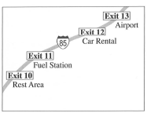

2
M-Cn: We're getting close to the airport, so we'd better stop to put gas in the car. The rental company will (1) ............................ an (2) ................... ................... for fuel if they have to do it.
W-Br: Good idea. We don't want to pay more than we have to.
M-Cn: OK, should I take this exit then?
W-Br: No, that's a (3) ......................... ..................... Keep going, we want (4) ............. ............. .........................
M-Cn: Oh good, and I hope they also sell food. Then we can (5)…………………………… …………………………… for the plane while we're there.
charge us
extra fee
1
What are the speakers concerned about?
A. Finding a parking space
B. Missing a flight
C. Paying an additional charge
D. Avoiding heavy traffic
2
Look at the graphic. Which exit does the woman tell the man to take?
rest area
A. Exit 10
B. Exit 11
C. Exit 12
D. Exit 13
the next exit.
3
pick up some snacks
What does the man say he hopes to do?
A. Buy some food
B. Pick up a map
C. Make a phone call
D. Purchase souvenirs

Slide 6
VOCABULARY
Concerned /kənˈsɜːnd/ (adj): băn khoăn, lo lắng
Avoid /əˈvɔɪd/ (v): tránh, ngăn ngừa
Souvenir /ˌsuː.vənˈɪər/ (n): quà lưu niệm
Charge /tʃɑːdʒ/ (n/v): tiền phải trả/ tính giá
Fuel /ˈfjuː.əl/ (n): nhiên liệu

Slide 7
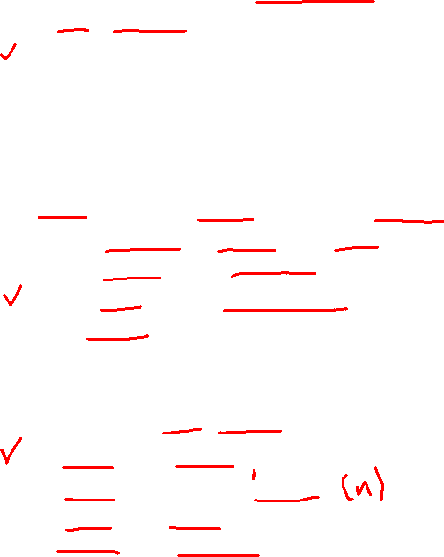
1
3
What most likely is the woman's job?
A. Lab technician
B. Receptionist
C. Pharmacist
D. Doctor
calling from
W-Br: Hi, Mr. Lin, I'm (1) ................ ................. Central Dentistry. You have (2) ............. .................................... with Dr. Sumner on June eighth at two P.M. I was wondering if we'd be able to (3) ......................... your appointment (4) ............. ............ .............
M-Cn: Well, I have a sales call scheduled that morning, but I think three o'clock would be all right.
W-Br: Wonderful, we really appreciate it. Most of our staff will be attending a dental workshop earlier in the day, and they are concerned about getting back in time.
M-Cn: No problem at all. I’ll mark down that change in (5) ......................... ......................... right now.
an appointment
2
move
to three o'clock
What does the woman want to change?
A. The quantity of items in an order
B. The location of a seminar
C. The time of an appointment
D. A payment schedule
3
What will the man do next?
A. Update his calendar
B. Submit his medical records
C. Review an invoice
D. Prepare an agenda
my calendar

Slide 8
VOCABULARY
Lab technician: kĩ thuật viên phòng máy
Receptionist /rɪˈsep.ʃən.ɪst/ (n): lễ tân
Pharmacist /ˈfɑː.mə.sɪst/ (n): dược sỹ
Quantity /ˈkwɒn.tə.ti/ (n): số lượng
Agenda /əˈdʒen.də/ (n): chương trình cuộc họp
Medical record: hồ sơ bệnh án
Appreciate /əˈpriː.ʃi.eɪt/ (v): cảm kích, đánh giá cao

Slide 9
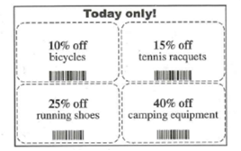
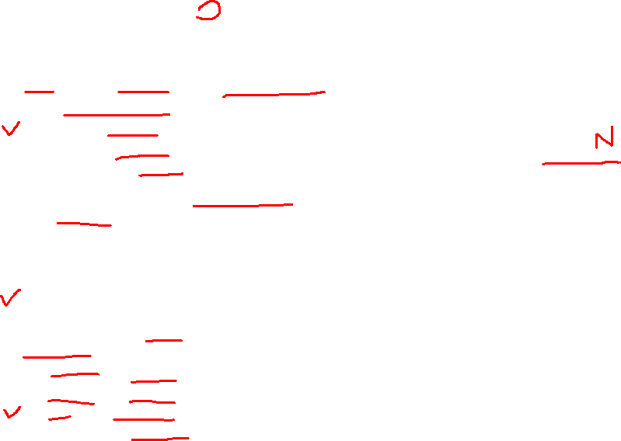
4
open our sporting
W: Hi, George. We’re all set to ......................... ......................... goods store next week. As we discussed, we’ll be offering ...................... ...................... on our opening day.
M: Here, I put together a flyer of coupons that we can give away at the store entrance.
W: Nice. I think the savings on running shoes will get customers into the store, but I’ve been thinking... I’m .................. .................... the discount on ….................. …………………... We probably won’t make money on those sales.
M: I agree. We ..................... ................. the discount by ...................... amount. I can make the change and print out a copy.
W: Good. Then I’ll drop it off at .................... .................. first thing ......................... .
special discounts
1
What is the occasion for the special sale?
(A) A store anniversary
(B) A public holiday
(C) A grand opening
(D) A customer contest
2
Look at the graphic. Which discount will be changed?
concerned about
camping equipment
(A) 10%
(B) 15%
(C) 25%
(D) 40%
should lower
half that
3
What does the woman say she will do tomorrow?
(A) Receive a shipment
(B) Contact a caterer
(C) Go to a print shop
(D) Organize a display
the printers
tomorrow

Slide 10
VOCABULARY
Sporting goods store /ˈspɔːrtɪŋ ɡʊdz stɔːr/: cửa hàng đồ thể thao
Flyer of coupons /ˈflaɪər əv ˈkuːpɒnz/: tờ rơi phiếu giảm giá
Concerned about /kənˈsɜːrnd əˈbaʊt/: quan tâm về
Camping equipment /ˈkæmpɪŋ ɪˈkwɪpmənt/: dụng cụ cắm trại
Caterer /ˈkeɪtərər/: người phục vụ tiệc, nhà cung cấp dịch vụ ăn uống
Print shop /prɪnt ʃɒp/: cửa hàng in ấn

Slide 11
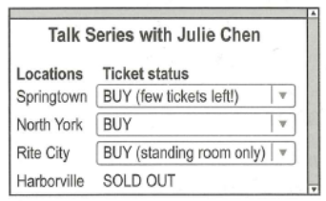
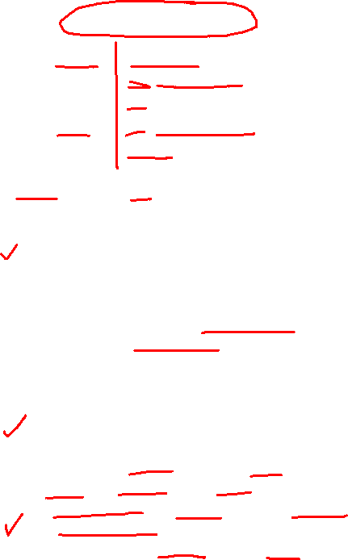
5
W: Hi, David. I just learned that Julie Chen is giving a talk on Saturday. She’s been a ..................... ................. for years. Our staff could ........... ............ ........... from someone with so much experience.
M: ................ ................ . And we could pay for the tickets if anyone else from sales wants to go...
W: Oh, wait. I just looked it up, and her talk is sold out. There ................ ................ .............. left for our location.
M: Oh, no! Well, let’s just ......................... ......................... at the department meeting. I’ve seen it, and it introduces useful strategies, too. I think our ............. ............... ............. to see it.
sales executive
learn a lot
1
What type of work do the speakers most likely do?
(A) Maintenance
(B) Sales
(C) Security
(D) Accounting
Great idea
2
Look at the graphic. Which location are the speakers interested in?
(A) Springtown
(B) North York
(C) Rite City
(D) Harborville
aren’t any tickets
3
play her latest video
What does the man suggest doing?
(A) Sending coupons to customers
(B) Demonstrating products at a trade show
(C) Showing a video at a meeting
(D) Buying an appliance for an office
staff would like

Slide 12
VOCABULARY
Sales executive /seɪlz ɪɡˈzɛkjʊtɪv/: nhân viên bán hàng, giám đốc bán hàng
Talk /tɔːk/: nói chuyện
Sold out /səʊld aʊt/: bán hết, cháy hàng
Strategies /ˈstrætɪdʒiz/: chiến lược
Demonstrate /ˈdɛmənstreɪt/: trình bày, biểu diễn
Trade show /treɪd ʃoʊ/: hội chợ thương mại
Appliance /əˈplaɪəns/: thiết bị, dụng cụ (thường dùng trong gia đình)

Slide 13
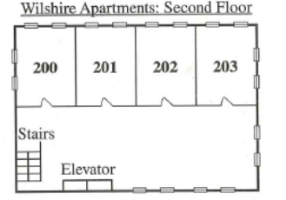
6
apartment
M: Hello, Tara. This is Sam Watson, the ......................... ................... .................... . Your rental agreement expires July first, and I was wondering if you’re planning to renew it.
W: Hi, Sam. To be honest, I haven’t decided yet. I like the apartment building and amenities, but I ............ ............. the location of my ......................... .
M: Oh, what’s the problem?
W: Well, I have the corner unit across from the stairs. I .................... people ................... when they’re on the stairs.
M: I understand. Well, there’s another apartment available on that same floor that I think you’d like. It’s also a ............................... , but it’s the one ................. ………......... from the stairs.
W: That sounds good. Could I see it?
building manager
1
Who is the man?
(A) A building manager
(B) A delivery driver
(C) A repair person
(D) An interior decorator
don’t like
apartment
2
What does the woman complain about?
(A) The high cost of a service
(B) The noise outside her apartment
(C) The length of a renovation project
(D) The limited access to parking
can hear
talking
3
Look at the graphic. Which apartment does the man mention?
corner unit
farthest away
(A) Apartment 200
(B) Apartment 201
(C) Apartment 202
(D) Apartment 203

Slide 14
VOCABULARY
Apartment building manager /əˈpɑːtmənt ˈbɪldɪŋ ˈmænɪdʒər/: quản lý tòa nhà chung cư
Rental agreement /ˈrɛntəl əˈɡriːmənt/: hợp đồng cho thuê
Expire /ɪkˈspaɪər/: hết hạn
Wonder /ˈwʌndər/: tự hỏi, ngạc nhiên
Amenity /əˈmɛnɪti/: tiện nghi, cơ sở vật chất

Slide 15
THANK YOU

